Slide 1

Framework Simulation Summary

Slide 2
Table of Contents
General Architecture
Simulated Scenarios:
Scenario 1: Worker attempting to enter a zone
Scenario 2: A worker is not wearing the safety hook
Scenario 3: Wind speed fluctuates
Scenario 4: Communication between peripheral and master zones
Analysis

Slide 3
General Architecture

Slide 4
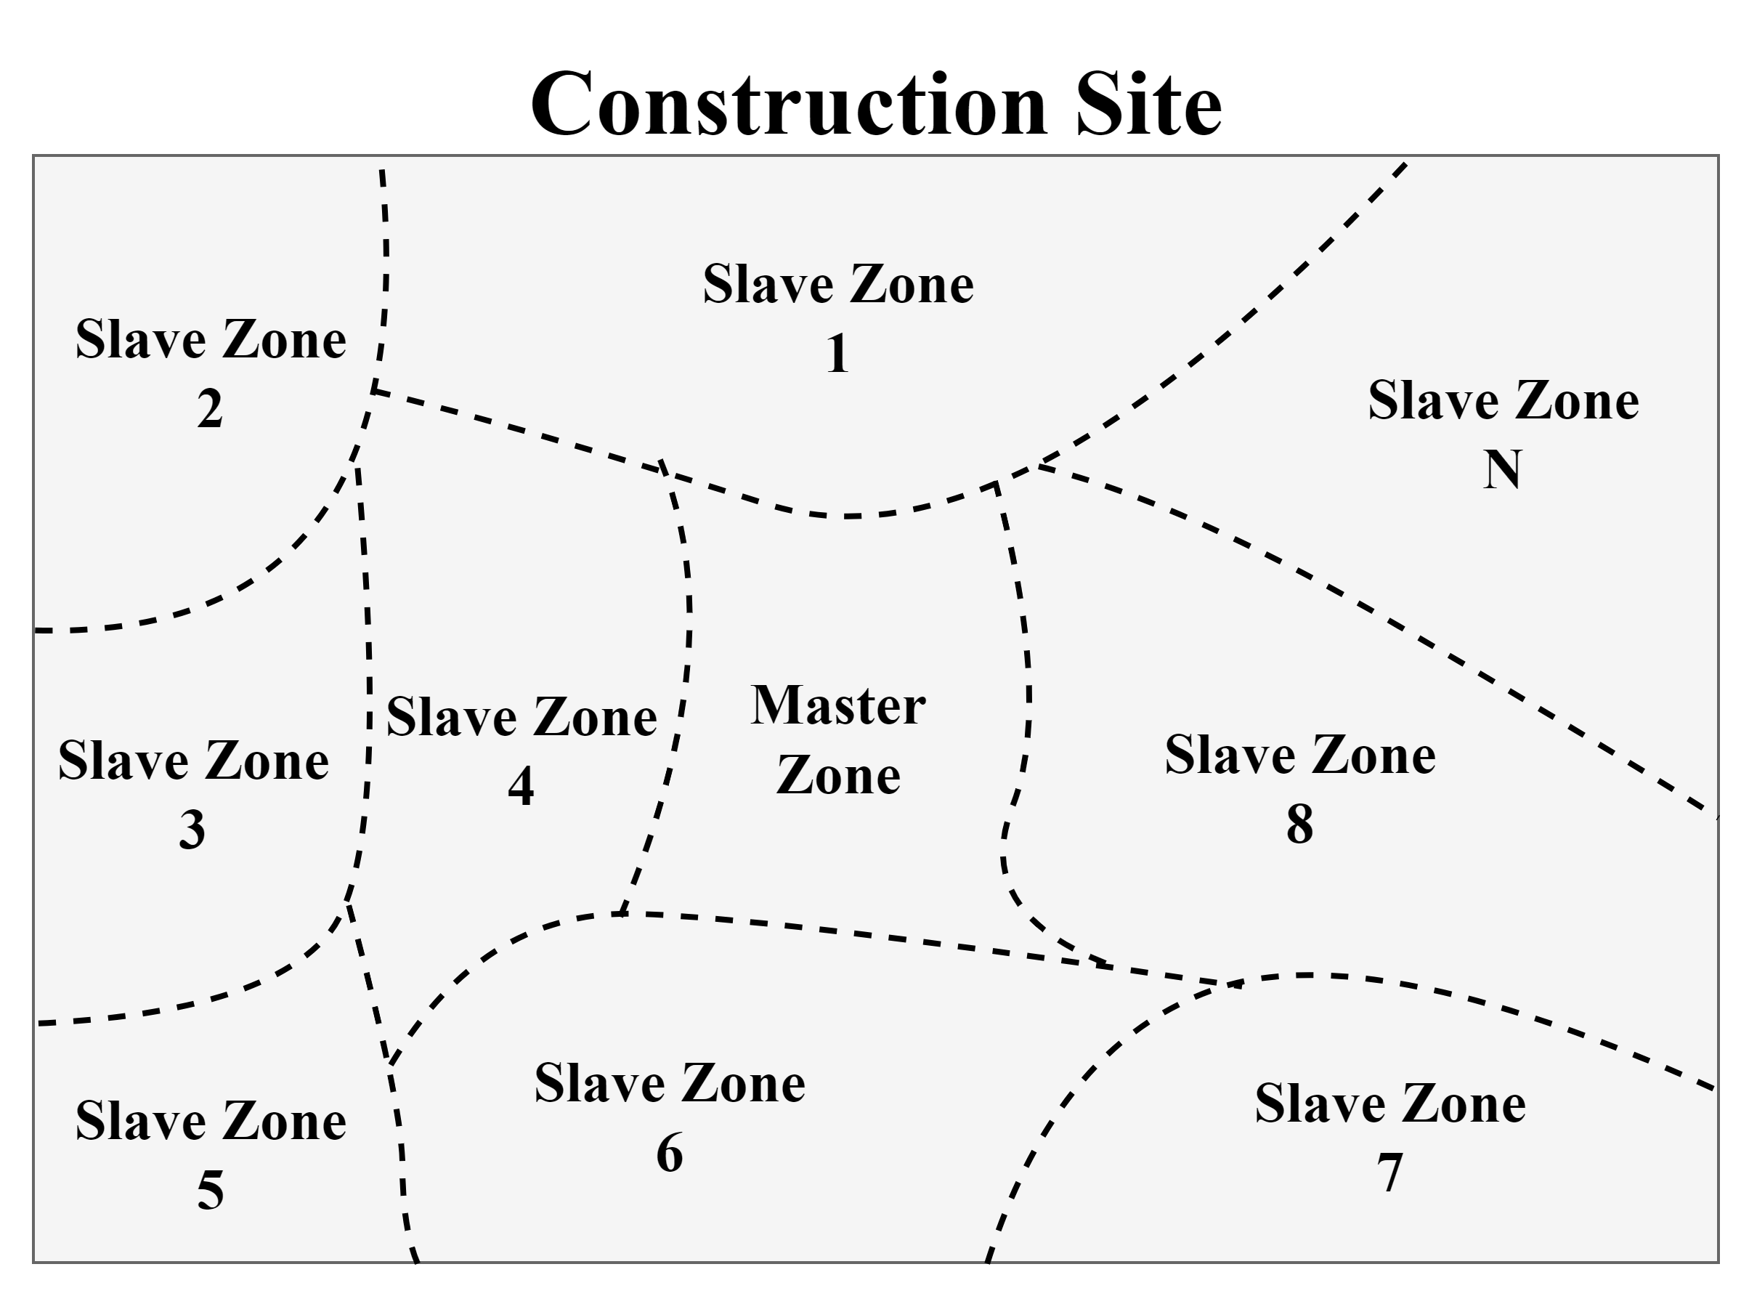
Site Layout

Slide 5
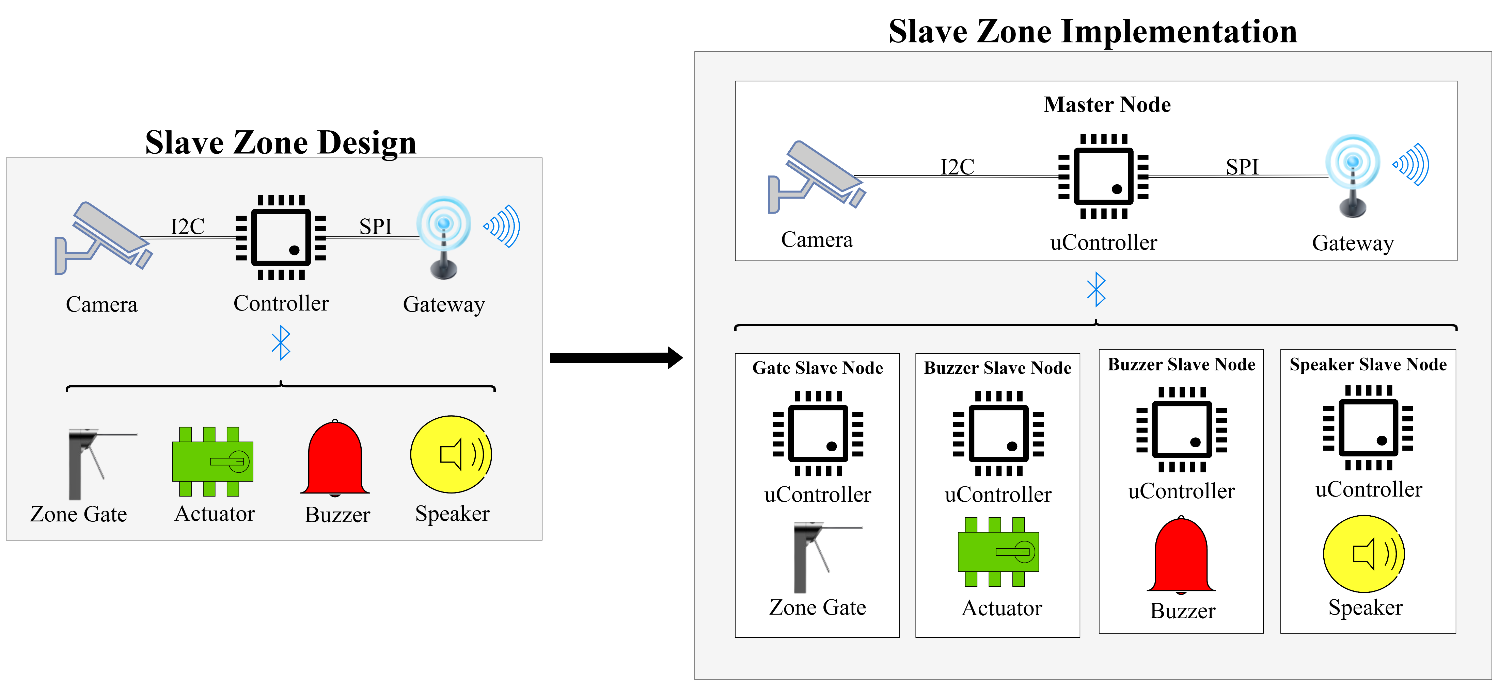
Slave Zone Implementation

Slide 6
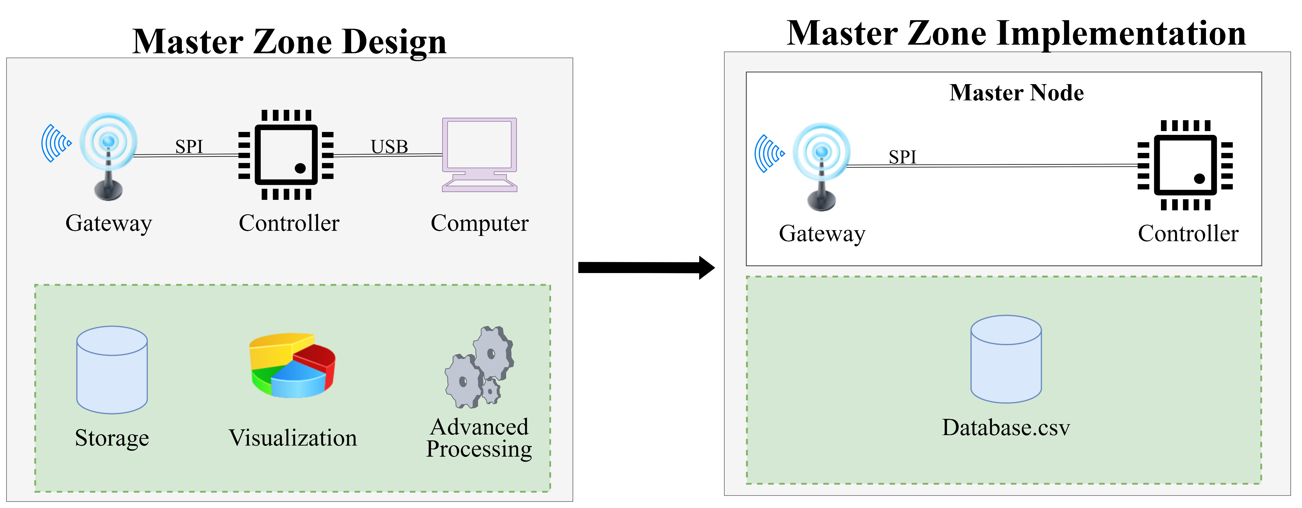
Master Zone Implementation

Slide 7
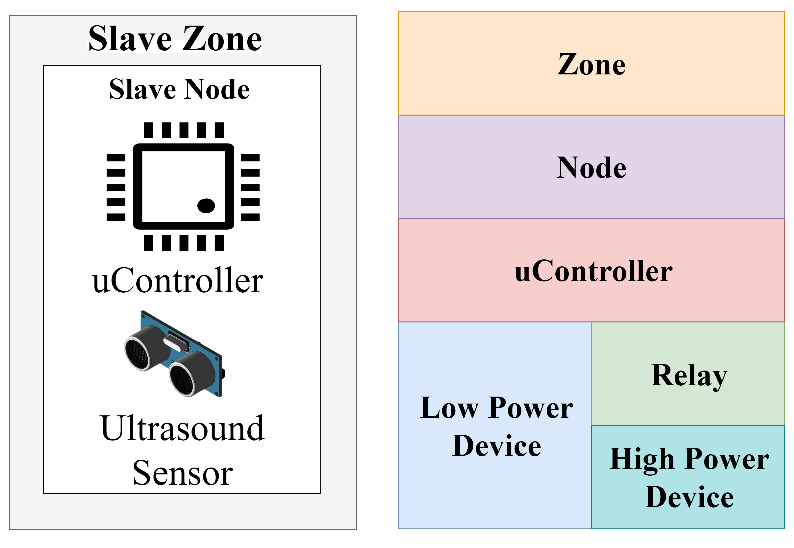
Hierarchical View of Layers (Example)
Ultrasound sensor is a low power device
Sensor is directly connected to a uController, which reads and sets fields in the device
Both ultrasound and uController represent real-life physical objects
Relay acts an interface between the controller and the device in case it’s a high-power device

Slide 8
Hierarchical View of Layers (Example) - Continued
Node is a container for the controller and its connected devices
Acts a single sensing or actuation unit
Does not represent a physical object but serves as a logical layer above uController.
This layer makes it easier to group together devices and a uController performing a single function into a single entity.
In this example, a uController connected to an ultrasound sensor is an “ultrasound slave node”
This node can then be replicated to simulate multiple instances of a uController connected to an ultrasound sensor on a construction site

Slide 9
Hierarchical View of Layers (Example) - Continued
Zone is a is a container for a set of nodes
Represents a region on a construction site
Also serves as a logical layer above node to handle communication between zones
This layer makes it easier to group together nodes operating and controlling a certain region on a construction site into a single entity

Slide 10
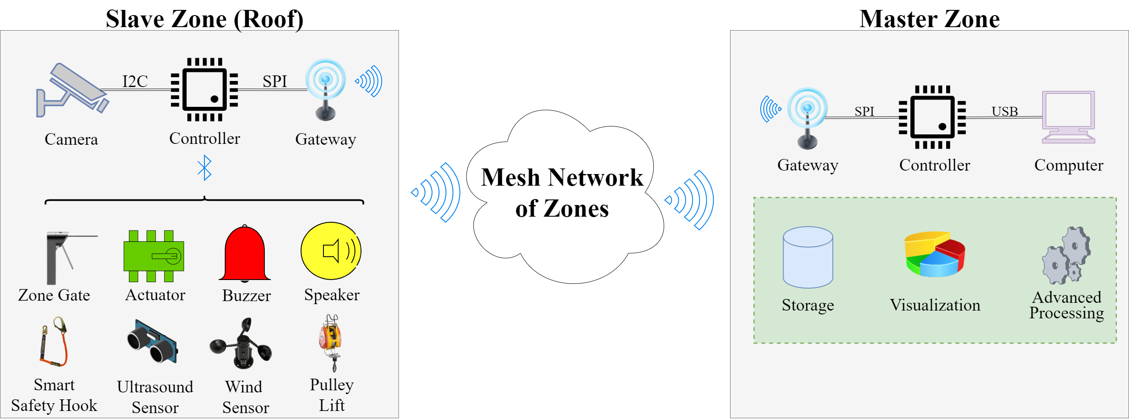
Roof - Master Communication (Design View)

Slide 11
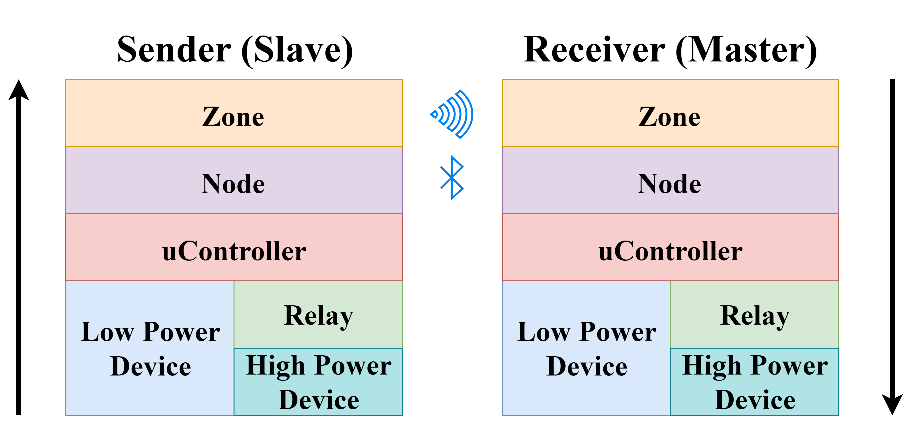
Communication through the Layers
Communication follows an approach similar to IP/TCP networking but with a different order
Data begins at the devices
uController reads them and pushes them upwards to the logical Node layer.
If communication is between nodes in the same zone, data is sent from slave node to master node using BLE
If communication is between different zones, the node layer pushes the data upwards to the Zone layer, which then sends the data to destination zone using WiFi

Slide 12
Simulated Scenarios

Slide 13
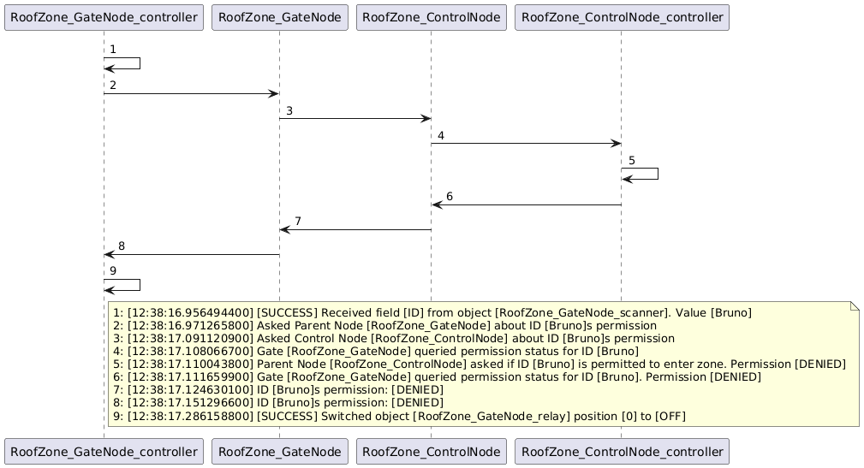
Scenario 1 – Logs [DENIED]

Slide 14
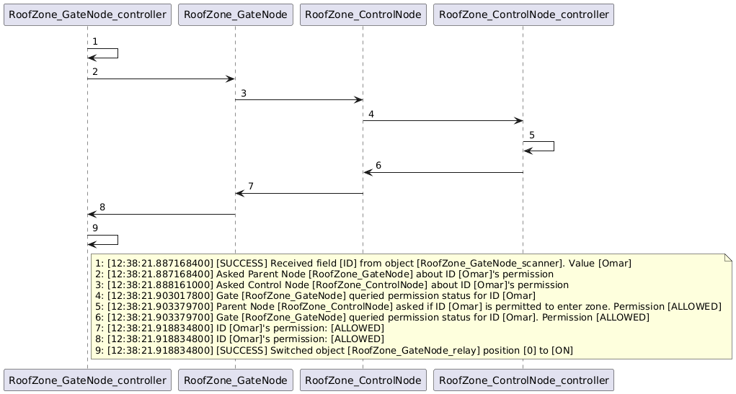
Scenario 1 – Logs [ALLOWED]

Slide 15
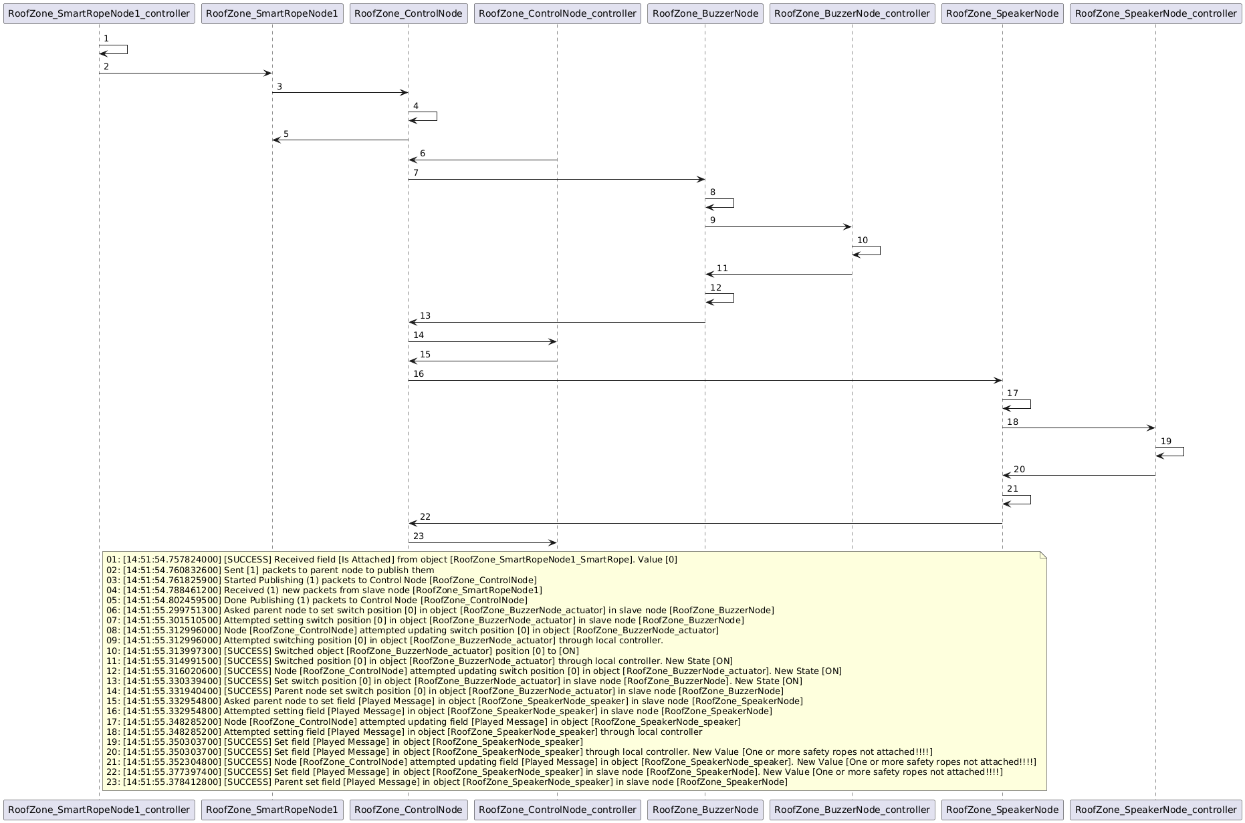
Scenario 2 – Logs [Not Wearing Hook]

Slide 16
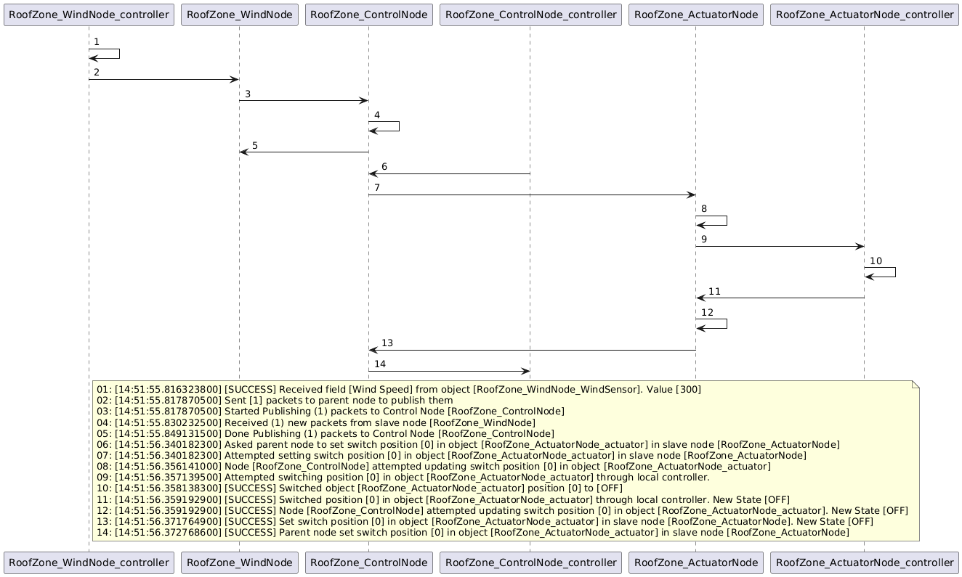
Scenario 3 – High Wind Speed

Slide 17
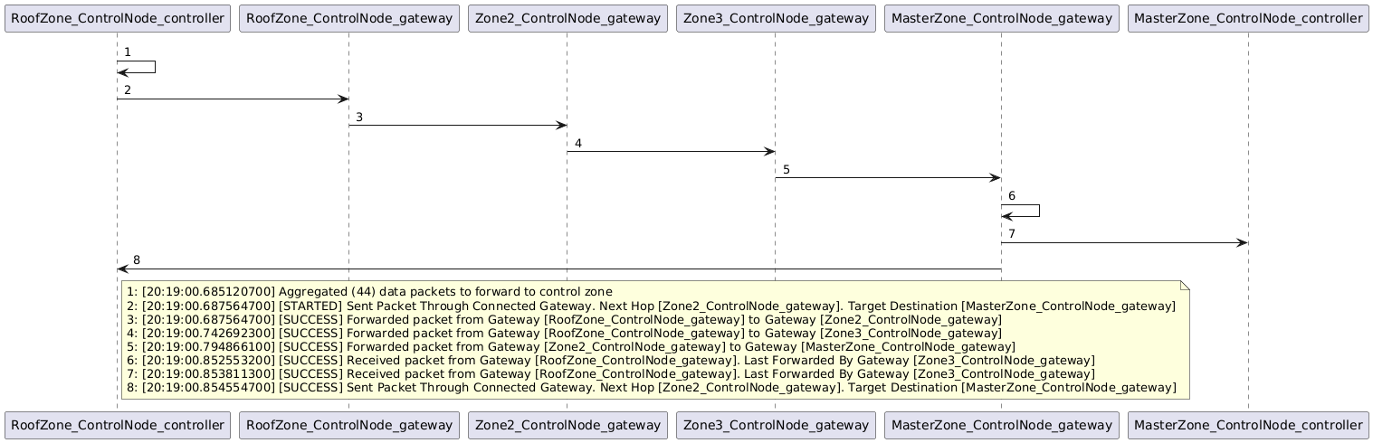
Scenario 4 – Communication between peripheral and master zones

Slide 18
Analysis

Slide 19
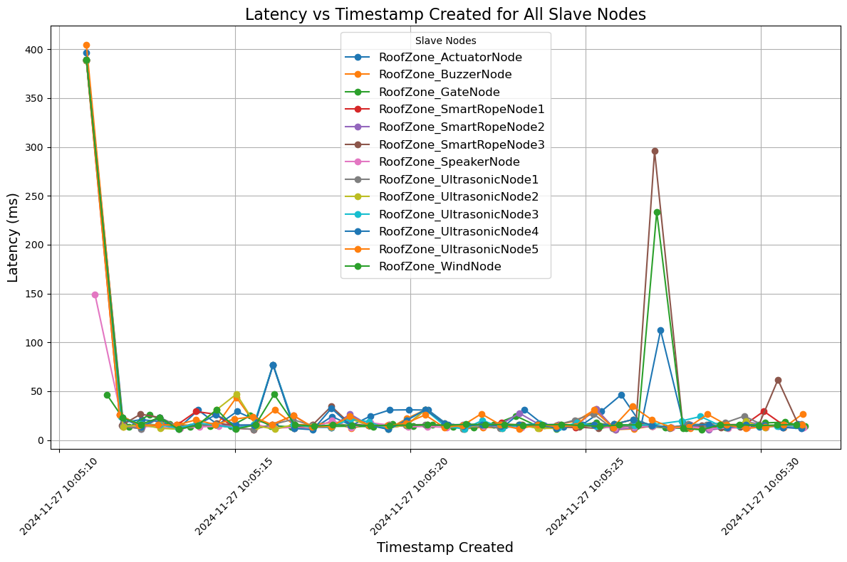
Latency between Slave Nodes and Master Node

Slide 20
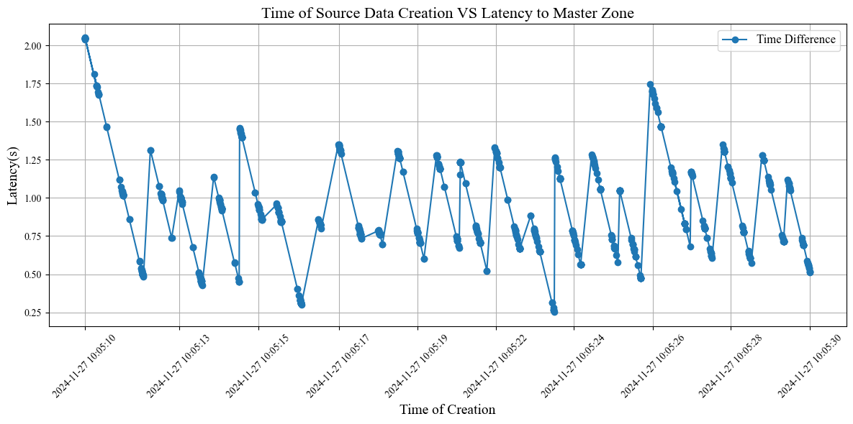
Latency between Slave Zone and Master Zone

